Slide 1
P2P email encryption by an identity-based one-way group key agreement protocol
Proceedings of IEEE ICPADS 2014
By
Jyh-haw Yeh
Boise State University

Slide 2
Current email systems with encryption – Google Gmail
Gmail has the http always-on as an default option:
Sending an email: Mail sender & the mail server establish a shared session key by an TLS session.
The mail server decrypt the email and stored the email in plain.
Receiving an email: Mail receiver & the mail server establish another session key by another TLS session.

Slide 3
Disadvantages of Gmail
Not a truly P2P email encryption.
Emails are stored in clear in Google’s servers.
Sending and receiving an email, each requires an expensive TLS protocol to establish a session key for encryption.

Slide 4
Current email systems with encryption - PGP
PGP: Pretty Good Privacy is an email encryption protocol, based on RSA PKI.
Truly point-to-point email encryption protocol.
Sending email: Use each recipient's public key to encrypt an IDEA key; and then Use the IDEA key to encrypt the message.
Receiving email: Use own private key to get the IDEA key and then use it to get the message.

Slide 5
Disadvantages of PGP
Require public-key certificate authority (CA) to verify everyone’s public keys.
Difficult to find a trusted third party to be a CA.
Tracking valid and revoked certificates requires extra work for the CA.
In a group email, encryption (IDEA) key needs to be encrypted multiple times, once for each receiver’s public key.

Slide 6
Target capabilities for P2P email encryption system
Truly P2P email encryption.
Not require public key certificate service.
No (or limited) performance penalty, compared to PGP’s PKI approach or Gmail’s https approach.
Flexible for group email encryption.

Slide 7
Identity-based encryption
Do not need any CA to issue certificates for public keys.
Everyone’s public key can be derived from his/her identity by a public known function.
Require a KDC (key distribution center) to generate the corresponding private keys for everyone.
Unlike CA, KDC provides services only when a user register at the first time.

Slide 8
A typical identity-based cryptosystem using bilinear pairing
Two cyclic groups (G1, +) and (G2, ×)
Let B be a generator of the group G1
Let e : G1 ×G1 → G2 be a bilinear mapping.
A public known hash function H : {0,1}∗ → G1 that maps a user’s identity to a point in G1
KDC selects a master secret S
Each user Ui’s public key Pi = H(Identity of Ui) ∈ G1
KDC computes the private key Si = S×Pi ∈G1

Slide 9
Proposed P2P email encryption using an ID-based group key agreement protocol
Each email user uses his email address as ID
Each user gets the private key from the KDC
Email sender generates an encryption key based on all recipient's’ public keys.
Email sender uses the key to encrypt message
Some key derivation information will be attached in the email
Each email recipient can derive the encryption key using his/her own private.

Slide 10
Key generation by email sender
Let ID0 be an email sender and there are n email recipients ID1, ID2 … IDn
For each recipient IDi, compute Xi = e(S0, rPi) ∈ G2, where S0: private key of ID0;
Pi: private key of Idi;
r: random number
Encryption key K = X1 ⊕ X2 ⊕ … ⊕ Xn
For each recipient, compute Yi = ⊕∀j≠ i (Xj), or
Yi = X0 ⊕ X1 ⊕...⊕ X(i−1) ⊕ X(i+1) ⊕...⊕ Xn
Send the encrypted email along with (r, Y1, Y2, ..., Yn)

Slide 11
Key re-generation by each email recipient
K = Yi ⊕ e(rP0, Si), where
Yi: key derivation information
P0: sender’s public key
Si: own private key
Yi ⊕ e(rP0, Si) =Yi ⊕ e(rP0, sPi) = Yi ⊕ e(sP0, rPi)
= Yi ⊕ e(S0, rPi) = Yi ⊕ Xi = (⊕∀j≠ i (Xj)) ⊕ Xi = K

Slide 12
Example: two recipients
Two recipients:
X0 = e(S0 , rP0) X1 = e(S0, rP1) X2 = e(S0, rP2)
K = X0 ⊕ X1 ⊕ X2
Y1 = X0 ⊕ X2 Y2 = x0 ⊕ x1
Three recipients:
X0 = e(S0, rP0) X1 = e(S0, rP1) X2 =e(S0, rP2) X3 = e (S0, rP3)
K = X0 ⊕ X1 ⊕ X2 ⊕ X3
Y1 = X0 ⊕ X2 ⊕ X3 Y2 = X0 ⊕ X1 ⊕ X3 Y3 = X0 ⊕ X1 ⊕ X2

Slide 13
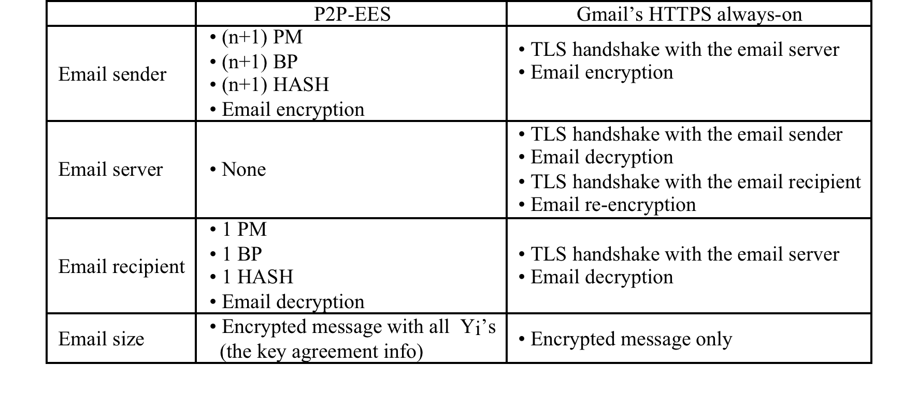

Slide 14
Experimental results: cryptosystem setup
The experiments were conducted on a machine with an Intel(R) Core(TM)i3CPU M330@2.13GHz processor, 4 GB RAM, and the 64-bit Windows 7 home premium operating system.
rBits | qBits | MKBits | Time (ms)
160 160 256 256 | 256 256 512 512 | 256 512 256 512 | 907 923 978 1239

Slide 15
Experimental results: user registration (public-private key pair generation)
rBits | qBits | MKBits | Email | Time (ms)
256 | 512 | 256 | fiona201301@gmail.com | 109
256 | 512 | 512 | fiona201301@gmail.com | 156
256 | 512 | 256 | fionazeng@u.boisestate.edu | 125
256 | 512 | 512 | fionazeng@u.boisestate.edu | 167

Slide 16
Experimental results: one recipient
Connection (Conn.); Key Derivation (Der.); Encryption (Enc.); Decryption (Dec.)
A Type A curve, with rBits = 256 and qBits = 512, was used
Msg. (char) | Sender |  |  | Recipient
 | Conn. (ms) | Der. (ms) | Enc. (ms) | Conn. (ms) | Der. (ms) | Dec. (ms)
524 | 4493 | 157 | 198 | 4926 | 153 | 698
3009 | 4953 | 168 | 224 | 4583 | 172 | 813
10658 | 5614 | 153 | 229 | 4922 | 144 | 935

Slide 17
Experimental results: two recipients
A Type A curve, with rBits = 256 and qBits = 512, was used.
Connection time is pretty stable in previous table and thus ignore here
Msg. (char) | Sender |  | Recipient 1 |  | Recipient 2
 | Der. (ms) | Enc. (ms) | Der. (ms) | Dec. (ms) | Der. (ms) | Dec. (ms)
524 | 335 | 202 | 103 | 681 | 98 | 662
3009 | 349 | 226 | 96 | 892 | 112 | 824
10658 | 389 | 276 | 101 | 1064 | 116 | 922

Slide 18
Experimental results: three recipients
A Type A curve, with rBits = 256 and qBits = 512, was used.
Msg. (ms) | Sender |  | Recipient 1 |  | Recipient 2 |  | Recipient 3
 | Der. (ms) | Enc. (ms) | Der. (ms) | Dec. (ms) | Der. (ms) | Dec. (ms) | Der. (ms) | Dec. (ms)
524 | 477 | 192 | 105 | 668 | 109 | 662 | 102 | 676
3009 | 498 | 212 | 96 | 876 | 112 | 824 | 107 | 864
10658 | 481 | 296 | 101 | 998 | 116 | 922 | 112 | 972

