Slide 1
Introduction to security goals and usage of cryptographic algorithms
By Jyh-haw Yeh

Slide 2
Security Goals
Privacy: hiding confidential information.
Data integrity: ensure data is origin and not forged.
Authentication: ensure who you “talk” to is really the person he/she claimed.
Authorization: authorize who should access what objects with what access privileges (read, write, execute, access right delegation, etc).
Availability: services/resources are available at the time users make requests.

Slide 3
Cryptographic Algorithms and Usage
Encryption: E(message) = cipher; D(cipher) = Message
Symmetric (secret) key algorithm: both parties share a secret key
Both Alice and Bob share a secret key
Alice uses the key to encrypt the message and sends the cipher to Bob
Bob uses the same secret key to decrypt the message
Asymmetric (public key) key algorithm: both parties have their own (public, private) key pair
Both Alice and Bob have a (public, private) key pair
Alice uses Bob’s public key to encrypt a message and send the cipher to Bob
Bob can use his own private key to decrypt the message
Question: What security goal(s) can be achieved?

Slide 4
Cryptographic Algorithms and Usage
Keyed Hash: H(key|message) = digest
Many to one mapping
One-way function (not reversible)
Change a bit in the input, then the output will be very different
Given a message, hard to find a message with the same digest
Hard to find two messages with the same digest
Communication scenario, assume Alice and Bob share a secret key K
Alice computes H(K|message) = digest
Alice sends both the message and the digest to Bob
Team discussion: If Bob would like to ensure the message he received is original and not forged, what actions he needs to do?
Question: What security goal(s) can be achieved?

Slide 5
Cryptographic Algorithms and Usage
Signature: usually use asymmetric key algorithm to sign a message.
Alice uses her private key to sign a message and everybody can use Alice’s public key to recover the message from the signature.
Not knowing someone’s private key, you can not forge his/her signatures
Communication scenario
Alice uses her private key to sign a message
Alice sends the message along with her signature to Bob
Team discussion: What actions Bob needs to do to verify Alice’s signature?
What security goal(s) can be achieved?

Slide 6
Cryptographic Algorithms and Usage
Challenge and response:
Alice and Bob share a secret key K in advance.
Alice sends a message {I’m Alice} to Bob.
Bob sends a challenge {E(1234, K)} to Alice.
Alice sends the response {1234} and her own challenge {E(9876, K)} to Bob.
Bob sends the response {9876} to Alice.
What security goal(s) can be achieved?

Slide 7
Cryptographic Algorithms and Usage
For challenge & response,
Try to describe the C&R back-and-forth messages between Alice and Bob if using a public key cryptographic algorithm, assuming both Alice and Bob know each other’s public key?
Try to describe the C&R back-and-forth messages between Alice and Bob if using a cryptographic hash algorithm, assuming Alice and Bob share a secret key?

Slide 8
Security principles
Question: using appropriate cryptographic algorithms in applications to achieve security goals without having to know the details of how these algorithms implemented, which security principle(s) applies to this crypto-algorithm usage?

Slide 9
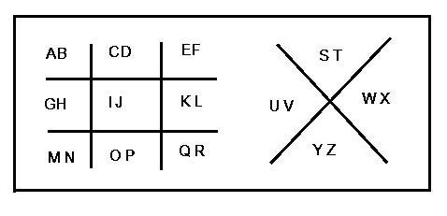
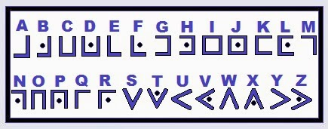
Legendary Cipher: Pigpen Code

Slide 10
Legendary Cipher: Pigpen Code
Well-known “encryption” algorithm without secret key. Not cryptographically strong!
What’s the pigpen code for “goodfeel”?
Activity:
form teams with only two members each team.
Send a short cipher to your teammate for decryption (decipher).

Slide 11
Legendary Cipher: Caesar Cipher (A Substitution Cipher)
Rot1 to Rot25 for the lower case alphabets.
For example, in Rot 2, a -> c, b->d, c->e …y->a, z->b.
Well-known encryption algorithm with a secret key. Not cryptographically strong!
Question: what is the encryption key?
Question: what is the Rot2 cipher for “goodfeel”?
Activity:
Agree with a secret key with your teammate (1-25).
Send a short cipher to your teammate for decryption (decipher)

Slide 12
Legendary Cipher: Random Cipher
Agree with your teammate a random one-time pad first. For example, a random permutation of the lower case alphabets.
The encryption/decryption algorithm: mapping each char to the corresponding char in the permutation. For example
Question: what is the encryption key?
Question: Not secure, why not?
a | b | c | d | e | f | g | …. | y | z
p | l | r | a | k | c | m |  | v | h

Slide 13
Secure Random Cipher
The random cipher can be cryptographically secure if
It is a bit-wise one-time pad and
Two parties are able to securely agree on the one-time pad with enough length

