Slide 1
Notes:
Put on loop as students filter in 10 mins prior to start: http://www.infinitelooper.com/?v=XRhGeau8RlE&p=n

Slide 2
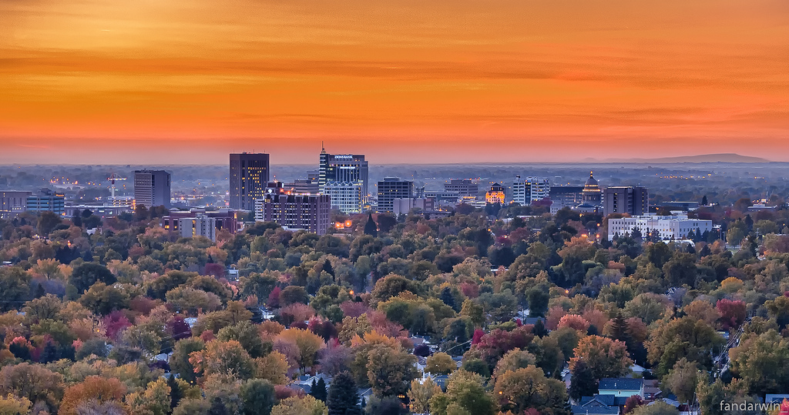
National Accolades - Boise
Next Top 10 Cities for Tech Jobs (#7) FastCompany | July 2015
#1 Best "Under the Radar Tech Hub" Sparefoot | May 2014
#6 Top State for Job Growth Forbes | January 2016
#1 State for Job Growth Governing.com | May 2015
Top 5 Places for Millennial Startups Tech.co | February 2016
#2 Top Up-And-Coming Cities for Recent College Grads
Forbes | June 2015
#11, The 35 Best U.S. Cities for People 35 and Under Vocativ | December 2014
#4 Healthiest City for Women Women's Health, December 2012
#1 Best City for Men Men's Health Magazine, December 2012
#1 Best City for Kids Livability.com | May 2014
#6 Best Place to Live US News & World Reports | March 2014
Top 100 Best Places to Live Livability.com | Sept 2015, Oct 2014
#7 Best City in America - "Livability" AreaVibes | May 2014
Top 10 Best "Big Cities for Active Families" Outside Magazine | 2014
#7 Best Place to Raise a Family Forbes | April 2014
#3 Best U.S. City to Raise a Family MomItForward.com, May 2013

Slide 3
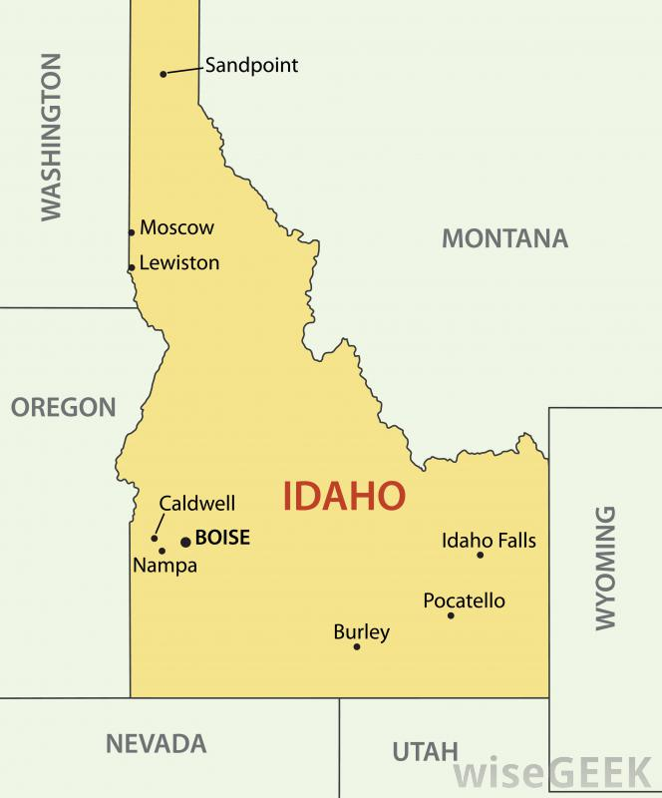
Tech Across Idaho
Notes:
Computer & Mathematical
14,017 2014 emloyment
18,354 2024 projection
4,337 net growth
6,337 annual openings

Slide 4
Computer and Math Occupations – Job Postings Geographic Distribution
Source: Wanted Analytics

Slide 5
Computer and Math Occupations – Job Postings
Source: Wanted Analytics

Slide 6
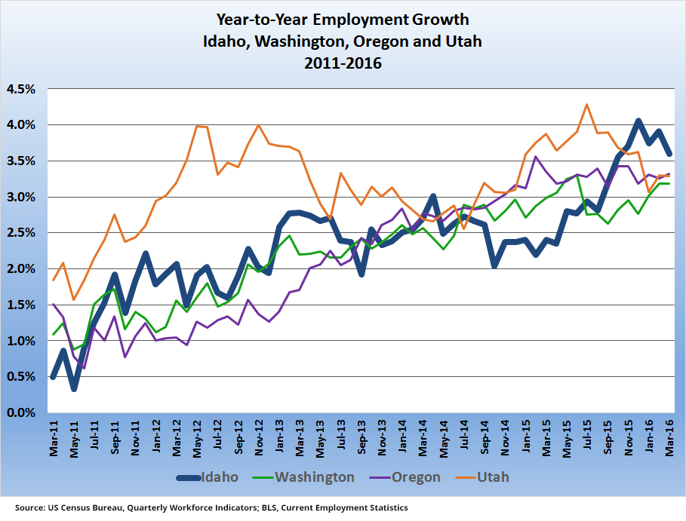
Employment
Notes:
As a share of its economy, Idaho added the most non-farm jobs of any state — 3.6 percent over the past year, followed by Oregon and Utah.
In terms of the tech sector specifically, Idaho is second only to Utah in growth, according to CompTIA’s Cyberstate 2016 report.
In 2015, Boise experienced the biggest growth in venture funding in the nation, according to the National Venture Capital Association.

Slide 7
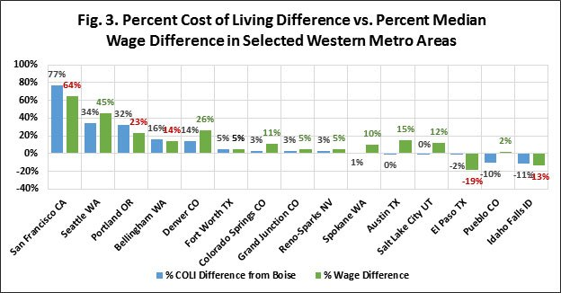
Cost of Living/Wages
Source: C2ER, COLI 2014; Bureau of Labor Statistics, Occupational Employment Statistics, 2014
Notes:
Should note that since 2014, wages have gone up but it’s hard to compare without this census report
This shows that Boise is somewhat close to its peers. Of course the argument for shortcomings in this factor comes down to quality of life and other benefits such as Boise having better air quality and shorter commutes than SLC.

Slide 8
Employer Connections
Just a few local companies working with the Dept. of Labor:
#IDTechJobs
labor.Idaho.gov/techjobs

Slide 9
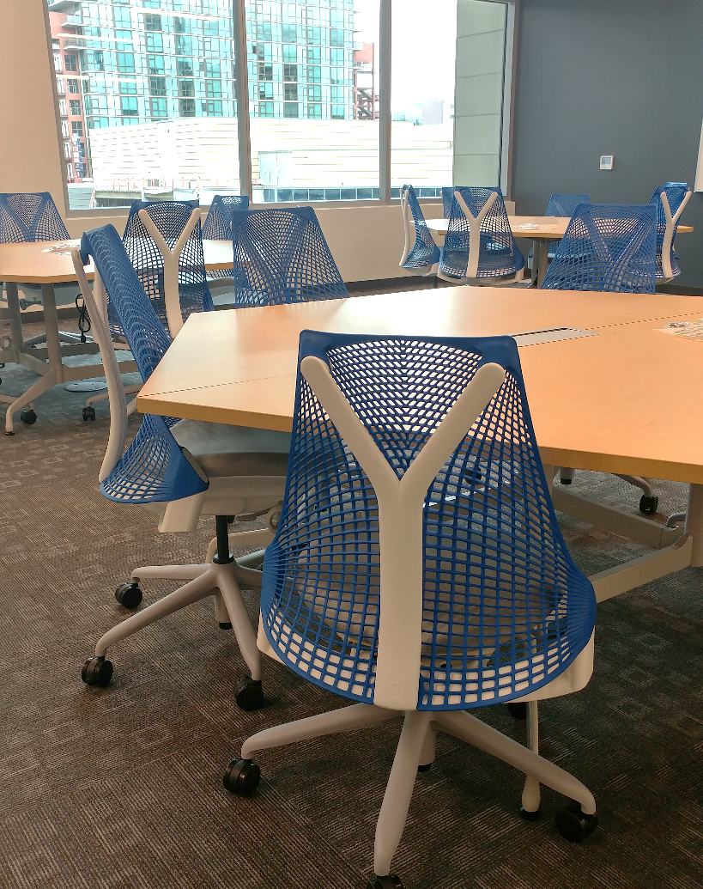
Boise State CS Programs
BS in Computer Science
Emphases in Cybersecurity and Secondary Education available
MS in Computer Science
PhD in Computing
Computational Science and Engineering
Computer Science
Cybersecurity
Data Science (Future)
Other Offerings
MS in STEM Education w/ CS Emphasis
CS Teacher Endorsement

Slide 10
Boise State Computer Science
20 Faculty
5 Lecturers
4 Post Docs
2015-16 Graduates
15%
85%
63 B.S. in CS
Undergrad Enrollment
Notes:
B.S. Graduates from prior years:
2016-17: Expected 90
2015-16: 63
2014-15: 47
2013-14: 27

Slide 11
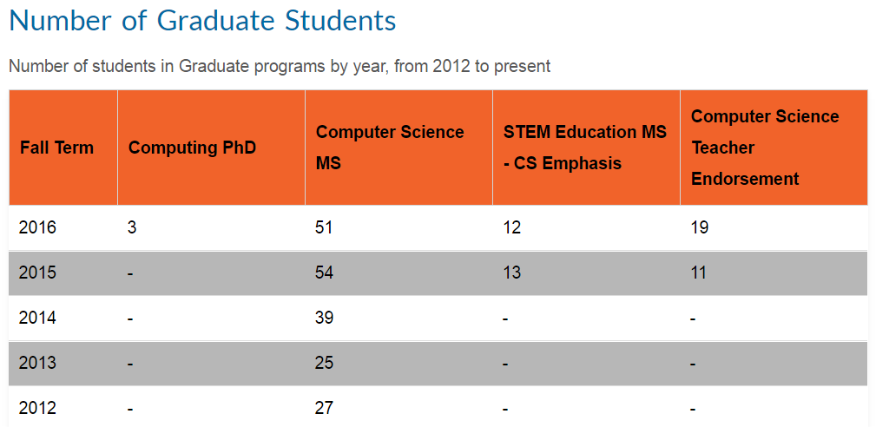
Graduate Program Enrollment
(23% W/77% M)
Notes:
Fall 2016 Grad Students:
25% BSU Undergrads, 75% Other University
54% Foreign, 46% Domestic
48% Full Time, 52% Part Time (many on their last semester or working in industry)
M.S. Graduates from prior years:
2016-17: Expected ?
2015-16: 7
2014-15: 8
2013-14: 4

Slide 12
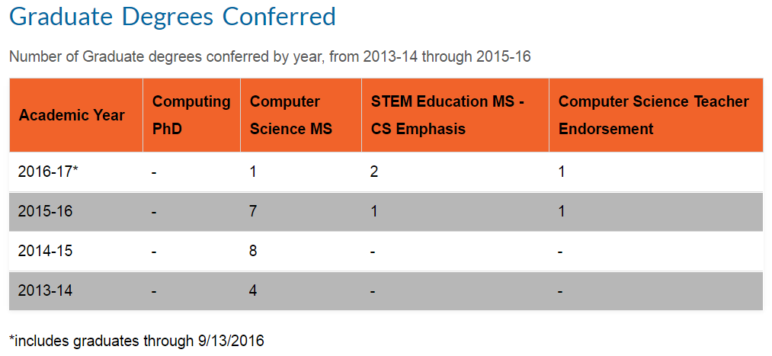
Graduate Program Degrees
Notes:
Fall 2016 Grad Students:
25% BSU Undergrads, 75% Other University
54% Foreign, 46% Domestic
48% Full Time, 52% Part Time (many on their last semester or working in industry)
M.S. Graduates from prior years:
2016-17: Expected ?
2015-16: 7
2014-15: 8
2013-14: 4

Slide 13
MS Program Requirements

Slide 14
PhD Program Requirements

Slide 15
Graduate Program Funding
Tuition
$8,440/year (9-15 credits)
$22,890/year non-resident (9-15 credits)
GEM Grad Scholarships waive the entire non-resident portion of tuition/fees. See http://bit.ly/GEMgradschol for more info.
Funding
Graduate Assistantships
$2K monthly stipend
Tuition/fees waived
Health insurance provided
To date, there are 25 funded GAs and on-going recruiting for more.
Notes:
Fall 2016 Grad Students:
25% BSU Undergrads, 75% Other University
54% Foreign, 46% Domestic
48% Full Time, 52% Part Time (many on their last semester or working in industry)
M.S. Graduates from prior years:
2016-17: Expected ?
2015-16: 7
2014-15: 8
2013-14: 4

Slide 16
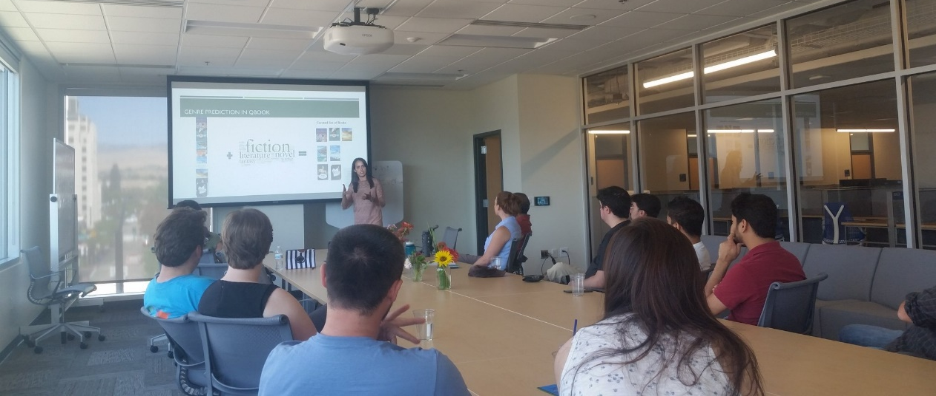
Graduate Program Research Areas
Research Areas
Artificial Neural Networks
Big Data & Data Science
Bioinformatics
Cloud Computing
Computational Science & Engineering
Computer Science Education
Cybersecurity
Data Mining
Distributed Systems
Graphics & Visualization
High Performance Computing
Human Computer Interaction
Information Security & Privacy
Machine Learning & Information Retrieval
Natural Language Processing
Operating Systems
Parallel Computing
Software Engineering
Notes:
Fall 2016 Grad Students:
25% BSU Undergrads, 75% Other University
54% Foreign, 46% Domestic
48% Full Time, 52% Part Time (many on their last semester or working in industry)
M.S. Graduates from prior years:
2016-17: Expected ?
2015-16: 7
2014-15: 8
2013-14: 4

Slide 17
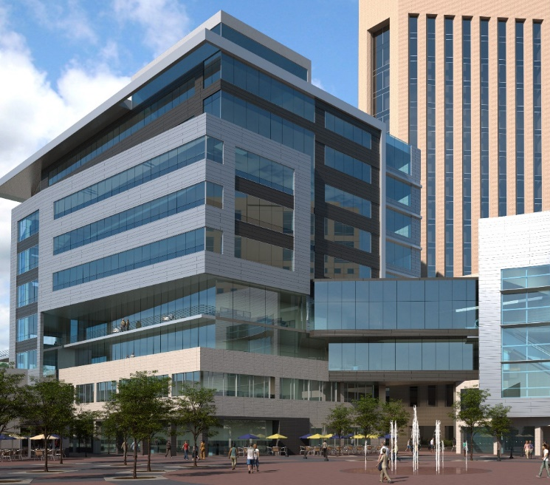
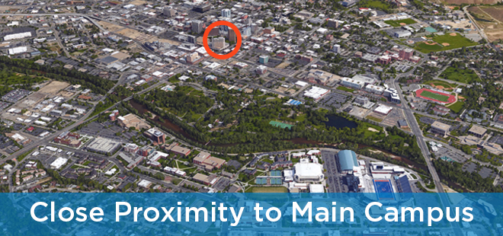
City Center Plaza – Our New Home

Slide 18
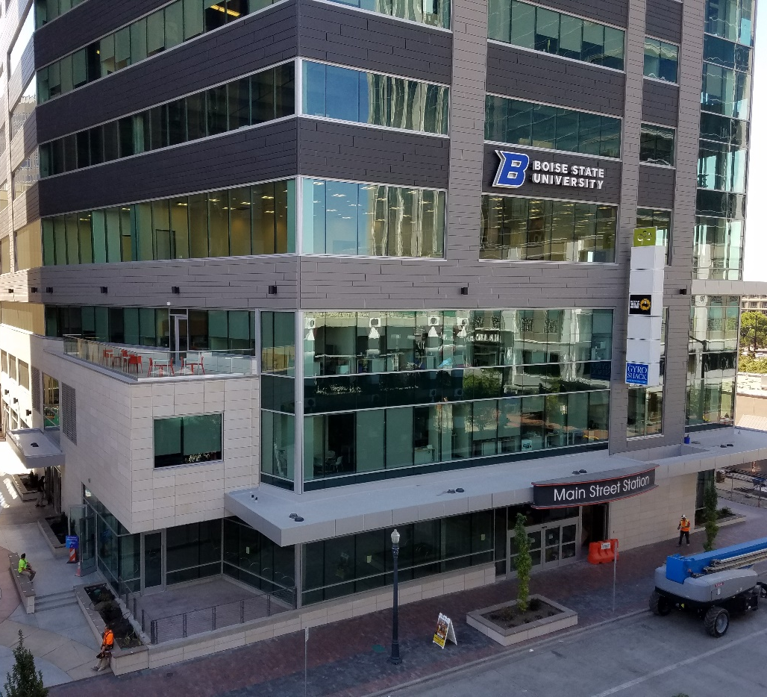
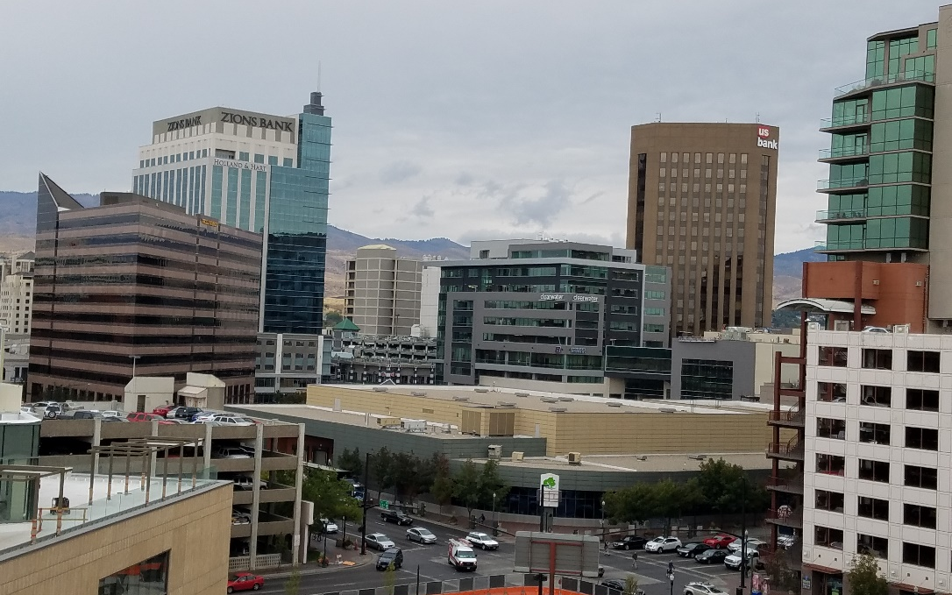
City Center Plaza – Our New Home

Slide 19
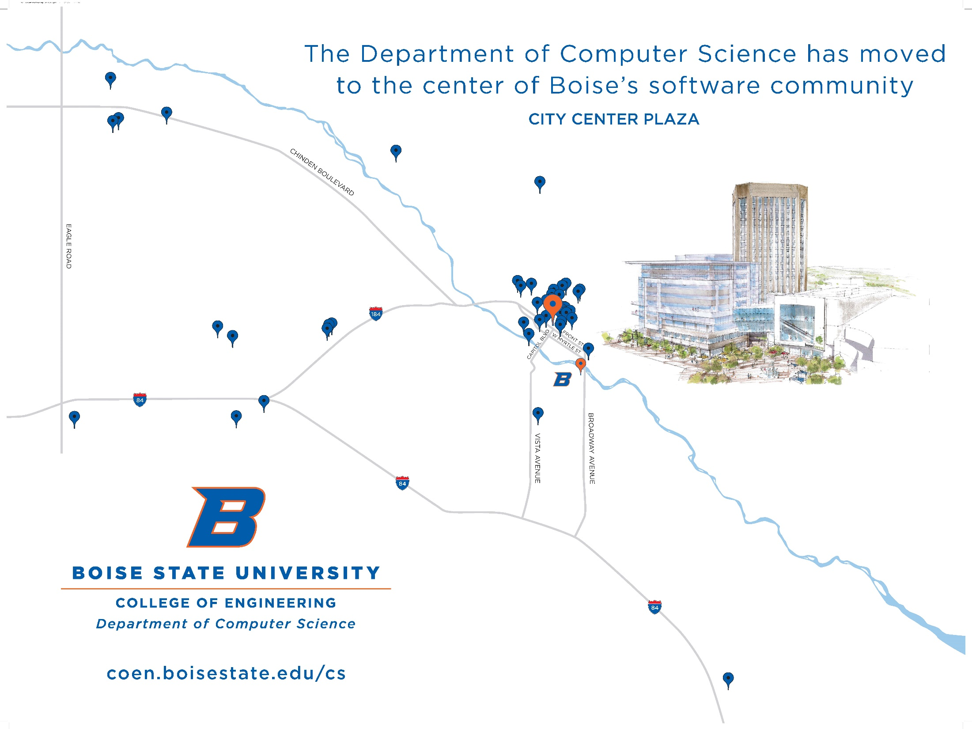
bit.ly/BOI-SW-Ecosystem
Notes:
“By clustering near each other, innovators foster each other’s creative spirit and become more successful.”

Slide 20
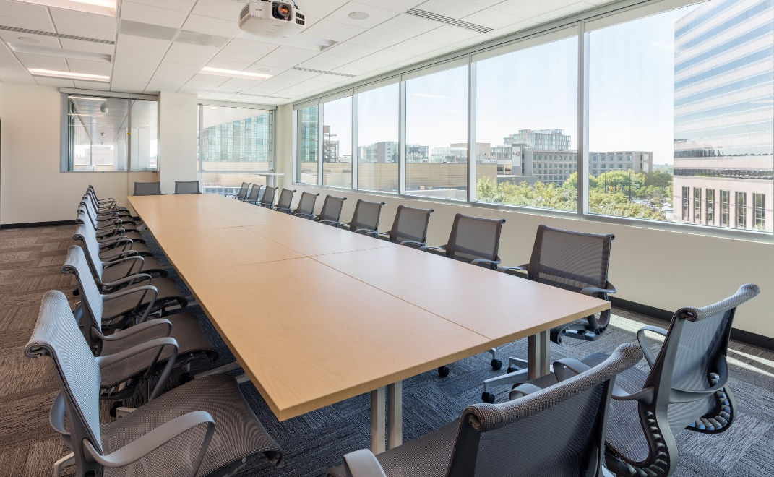
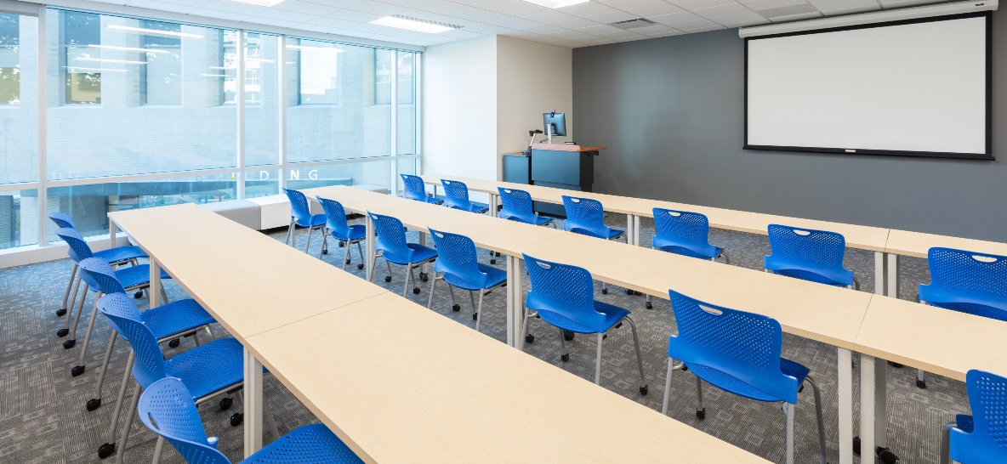
City Center Plaza – Our New Home

Slide 21
Applying for the Graduate Programs
Applicants:
Must have a baccalaureate degree in
computer science or related field
Minimum GPA of 3.0
Must have completed the GRE
Apply online at any time
(coen.boisestate.edu)
Application Fee Waiver!
Application fees:
$65 for residents
$95 for non-residents
Make sure to note your presence on the sign-in sheet to have these fees waived upon application!
Notes:
Acceptance rates are probably around 50%
Current Grad Students:
Average GRE scores from 2015: Quantitative-158.9, Verbal-148.8, Analytical/Writing-3.1
Average Overall Undergraduate GPA from 2015: 3.56

Slide 22
Thank you! Questions?

Slide 24
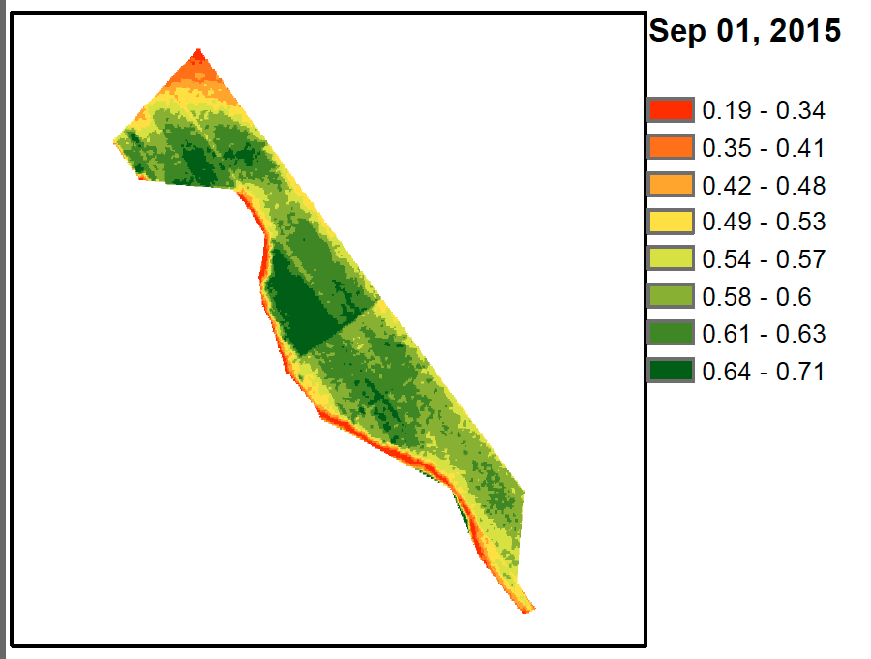
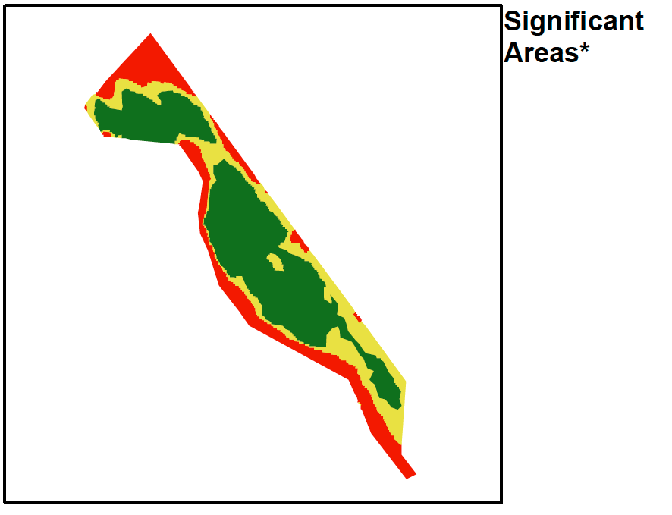
Joint Research Example – Simplot Grant
Analyze image data to identify problem areas
Aggregate historical, field, and sensor data
Help farmers determine management zones and treatments, and plan crop rotations
Predict future yield patterns

Slide 25
MAY 30th – JULY 30th 2016
Due: March 1st
Available to Sophomores or Juniors on Fall/Winter track
$4,500 stipend and paid housing/meals/travel expenses
Notes:
Participants will improve their ability to formulate and solve a research problem and increase their communication proficiency in both a scientific and community context.

Slide 26
Universities of Idaho Tech Challenge
Idaho university teams will be tasked with creating an educational app focused on Idaho tourism, agriculture or healthcare
$10K Grand Prize, $7K in additional prizes
To be launched 2/22
Submissions due April 22nd

Slide 27
States Growth Comparison

Slide 28
Regional Pay Rate

