Slide 1
Ensemble Models and Random Forests
Matty Jones, Data Science Manager
October 13, 2020
Notes:
Hello everyone!
My name is Matty Jones, and I am the Data Science Manager at Kount. That basically means that I get to lead a team of 3 incredible Data Scientists and take credit for all the awesome things that they do.
One of the best things about our Data Science team at Kount is how diverse our backgrounds are. We have a software and web developer, a geomathematician who specialises in Network Science, a theoretical physicist from Stanford, and then me….

Slide 2
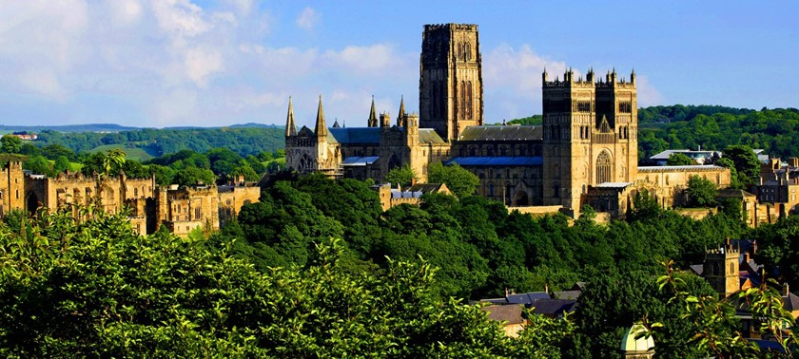
Notes:
I went to University in this beautiful place. This is the University of Durham in England and it is home to a thousand-year-old cathedral and castle.

Slide 3
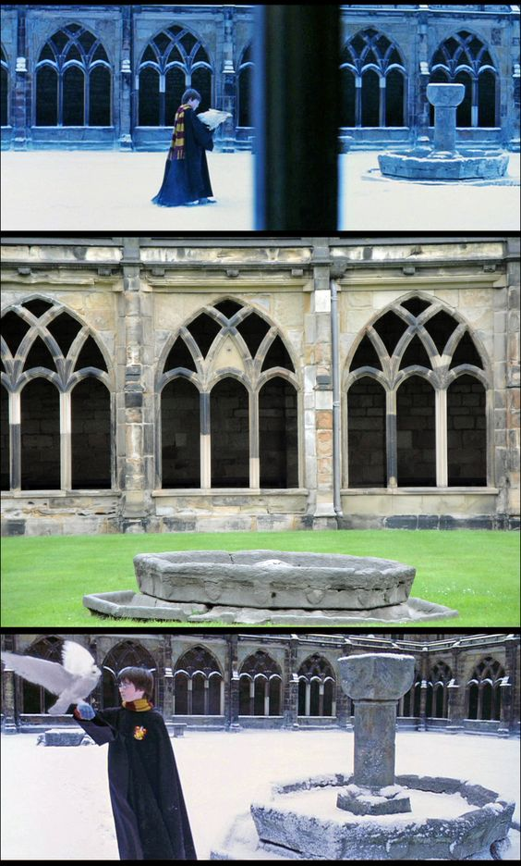
Notes:
One of Durham’s claims to fame is that they filmed some of the Harry Potter movies here. Hogwarts grounds were filmed in the Cathedral Cloisters, the Chapter House is the Transfiguration classroom and my wife took lectures twice a week in Professor McGonagall’s office.

Slide 4
Institute of
Particle Physics & Phenomenology
Notes:
I, on the other hand, spent most of my time in this fantastic-looking building – the Institute for Particle Physics and Phenomenology. For those who aren’t sure what that means exactly, don’t worry – I was there for 8 years and the best I can tell you is that it’s basically black magic.

Slide 5
Institute of
Particle Physics & Phenomenology
Witchcraft and Wizardry
Notes:
So, to summarise, I went to Hogwarts to study Witchcraft and Wizardry.

Slide 6
Institute of
Particle Physics & Phenomenology
Witchcraft and Wizardry
Notes:
After getting my Masters in Astophysics and a PhD in Engineering, I moved to Boise and worked in Materials Science for 3 years as a Postdoc before starting at Kount in 2018.
The point I’m trying to make here is that there is not one single path to becoming a data scientist. If you can get some try and collect experience of statistics, programming, and research for your choice of a whole manner of disciplines, you will look like an attractive hiring choice for your pick of Data Science positions across the country.

Slide 7
Ensemble Models
Notes:
Anyway, today Conrad has brought me in to talk to you about one of my favourite concepts in Machine Learning and Data Science – ensemble learning and specifically the Random Forest algorithm.

Slide 8
Ensemble Models – Greek Philosophy
“The whole is greater than the sum of its parts”
-- Aristotle (or maybe Proclus or Aquinas or Hesiod…)
Notes:
You guys have had a few lectures now on all sorts of different algorithms like SVM and decision trees. Ensemble methods are a powerful proof of the ancient philosophy that “The whole is greater than the sum of its parts”.
There is a phenomenon that you may have heard of call the “Wisdom of the Crowds”. An example goes something like this:

Slide 9
Ensemble Models – Wisdom of the Crowds
ENGLAND, 1906
Notes:
Picture this: England, 1906. It’s everyone’s favourite time of year – the West of England Fat Stock and Poultry Exhibition!

Slide 10
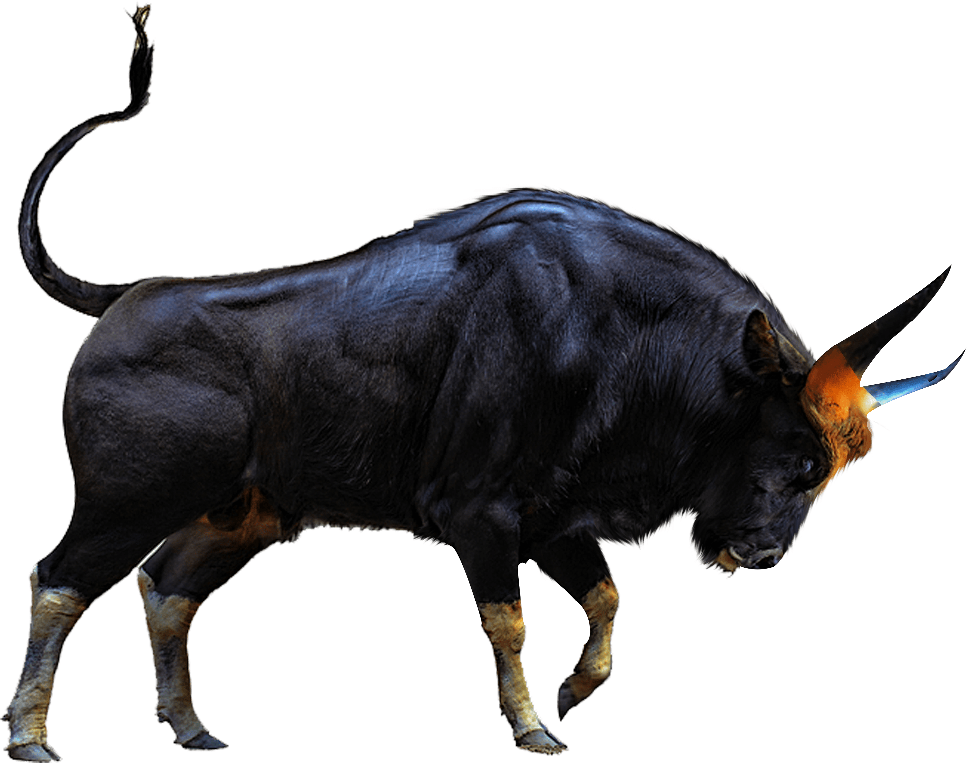
Ensemble Models – Wisdom of the Crowds
Guess the Weight of the Bull and You Take it Home!
ENGLAND, 1906
Notes:
This year, a truly beautiful creature – a huuuuge bull – has been turned into a friendly competition. The name of the game is “Guess the weight of the bull and you get to take it home” and it’s the absolute talk of the town.

Slide 11
Ensemble Models – Wisdom of the Crowds
Guess the Weight of the Bull and You Take it Home!
Small Child: 200 lbs
Random Farmer: 2,000 lbs
Person 3: 863 lbs
Person 4: 1,631 lbs
Person 5: 8,412 lbs
Person 787: 694 lbs
…
ENGLAND, 1906
Notes:
So popular was this game that a whopping 787 people all decided to try their luck at winning the bovine. Now some of these 787 people are not very experienced at guessing the weight of the bull, and so they massively underestimated its weight. “200 lbs!” blurted out a small child to the guffaws of some passing farmers. “No way, that thing is huge! It’s probably much more like 2000 lbs!”. For every underestimator, it seemed, there was someone who overestimated the weight of the bull by a comparable amount.

Slide 12
Ensemble Models – Wisdom of the Crowds
Guess the Weight of the Bull and You Take it Home!
Small Child: 200 lbs
Random Farmer: 2,000 lbs
Person 3: 863 lbs
Person 4: 1,631 lbs
Person 5: 8,412 lbs
Person 787: 694 lbs
…
Average: 1,197 lbs
ENGLAND, 1906
Notes:
And so, at the end of the exhibition, all the predictions were collated and averaged. The average of all the guesses over the entire day came out at 1,197 lbs.

Slide 13
Ensemble Models – Wisdom of the Crowds
Guess the Weight of the Bull and You Take it Home!
Small Child: 200 lbs
Random Farmer: 2,000 lbs
Person 3: 863 lbs
Person 4: 1,631 lbs
Person 5: 8,412 lbs
Person 787: 694 lbs
…
Average: 1,197 lbs
Actual: 1,198 lbs
ENGLAND, 1906
Notes:
The actual weight of the bull? 1,198 lbs.
Even though each individual estimator had its own set of biases based on its personal experience with bulls in the past, by aggregating over all the predictions (in this case by just taking the simple mean), we were able to come up with a final result that was almost exactly right, and way closer than any of the individual guesses had been.

Slide 14
Ensemble Models – Wisdom of the Crowds – Machine Learning
Take input data and features
Notes:
You may already be able to see how we could apply this to a machine learning problem. Given a sample space of data and a feature list…

Slide 15
Ensemble Models – Wisdom of the Crowds – Machine Learning
Take input data and features
Train multiple models with different biases
Notes:
We can train multiple models on different subsets of the input data, and potentially use different subsets of features to force each model to have a different set of biases.

Slide 16
Ensemble Models – Wisdom of the Crowds – Machine Learning
Take input data and features
Train multiple models with different biases
Aggregate responses
Notes:
Then, we can combine the responses to make a final prediction, which reduces both the bias and the variance.

Slide 17
Ensemble Models – Wisdom of the Crowds – Machine Learning
Take input data and features
Train multiple models with different biases
Aggregate responses
Final prediction better?
Notes:
This final prediction can be way better than any of the individual models could have done on their own.

Slide 18
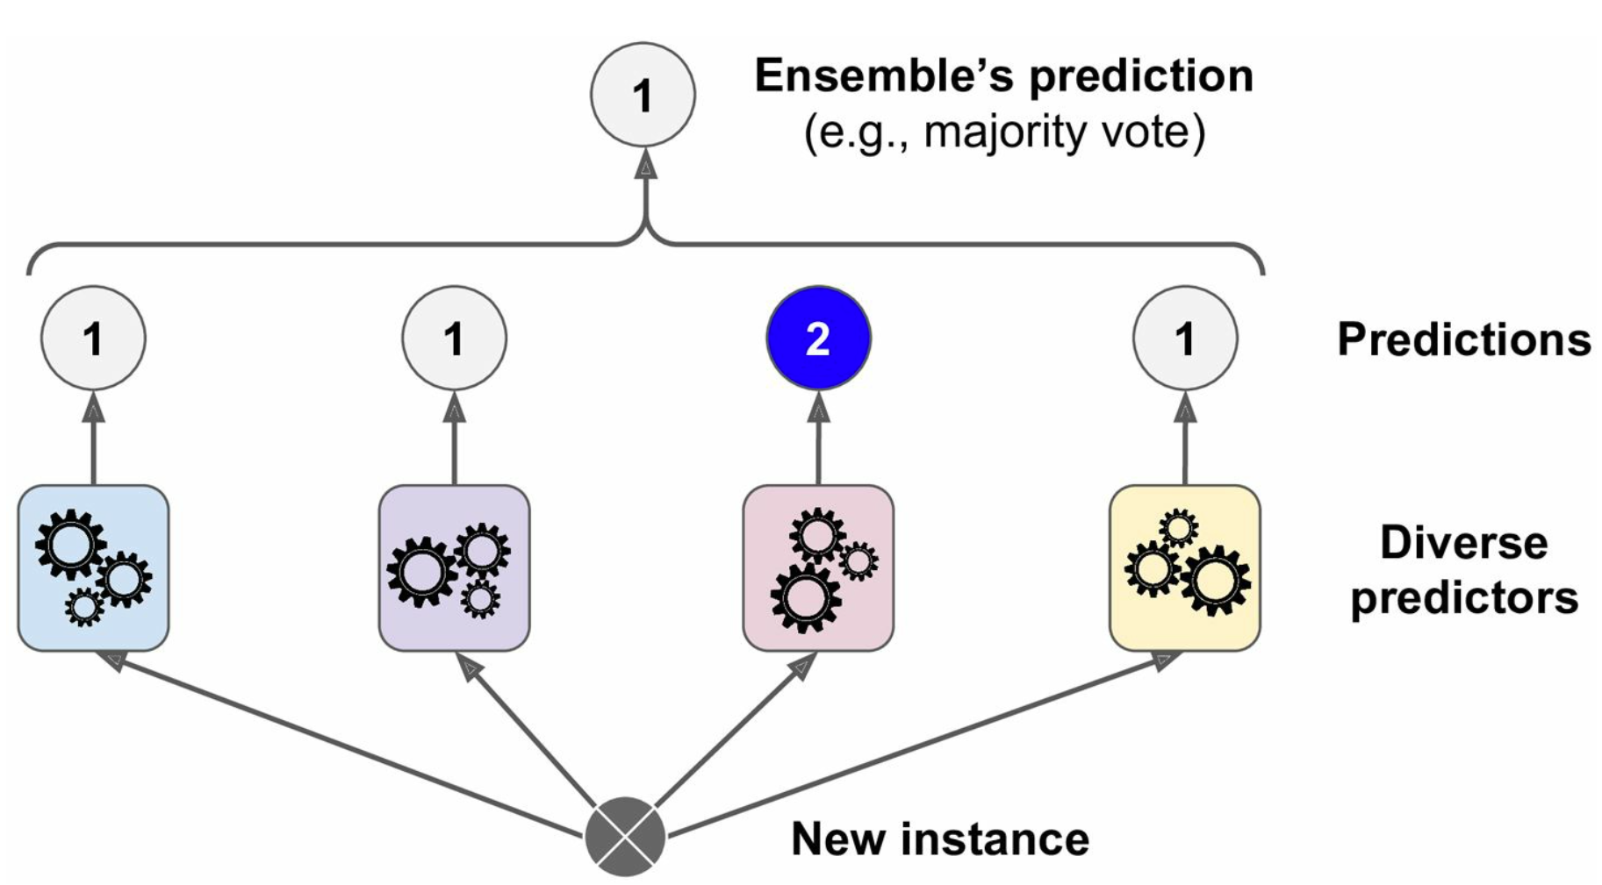
Ensemble Models – Wisdom of the Crowds – Machine Learning
(Hard Voting)
Notes:
Here’s a schematic of what this might look like. We have a set of diverse predictors with all their different intrinsic biases and each one makes its prediction on a new, incoming instance.
One way we can aggregate these predictions is by using a “Hard Voting” classifier, which simply takes the mode of the predictions to produce the final, ensemble prediction. This method has no information about the confidence that each predictor had in its classification prediction -- even if the blue, purple, and yellow predictors gave a borderline prediction of 1 and the red classifier was 100% confident in its prediction of 2, a Hard Voting Classifier will ignore the 2 and only ever report 1 as the final answer.

Slide 19
Ensemble Models – Wisdom of the Crowds – Machine Learning
2
(e.g., weighted mode)
(Soft Voting)
Low
Confidence
Low
Confidence
High
Confidence
Low
Confidence
Notes:
However, a ”Soft Voting” classifier can take into account the confidence that each predictor has by considering the argmax of the sums of the predicted probabilities. This effectively means that predictors that have higher confidence in their prediction are weighted more highly in the aggregation and often provides better performance -- particularly when the ensemble consists of well-calibrated predictors.
Regardless of the aggregation function used, the coolest thing about this is that even if each classifier in the group is a weak learner (i.e. only does slightly better than random guessing), the resultant ensemble can still be a strong learner that achieves high accuracy – as long as there are enough weak learners and they are sufficiently diverse to cover a broad range of biases
Let’s have a bit of a brain melting analogy of how this works.

Slide 20
Ensemble Models – Law of Large Numbers
P(H) = 0.51
P(T) = 0.49
Notes:
Imagine you have a slightly biased coin that has a 51% chance of coming up heads, and a 49% of coming up tails. It stands to reason that if you tossed the coin 1000 times, you would get pretty close to 510 heads and 490 tails.

Slide 21
Ensemble Models – Law of Large Numbers
P(H) = 0.51
P(T) = 0.49
P(H > T after 1,000) ~ 75%
P(H > T after 10,000) ~ 97%
P(H > T after ∞) → 100%
Notes:
If you consider all possible outcomes of 1000 tosses, you will find that the probability of obtaining a majority heads after 1000 tosses is about 75%. The more you toss the coin, the higher that probability goes – after 10,000 tosses, there is a 97% chance that you will have a majority heads. This asymptotically approaches 100% chance if you were to toss the coin an infinite number of times, and is called the “law of large numbers”.

Slide 22
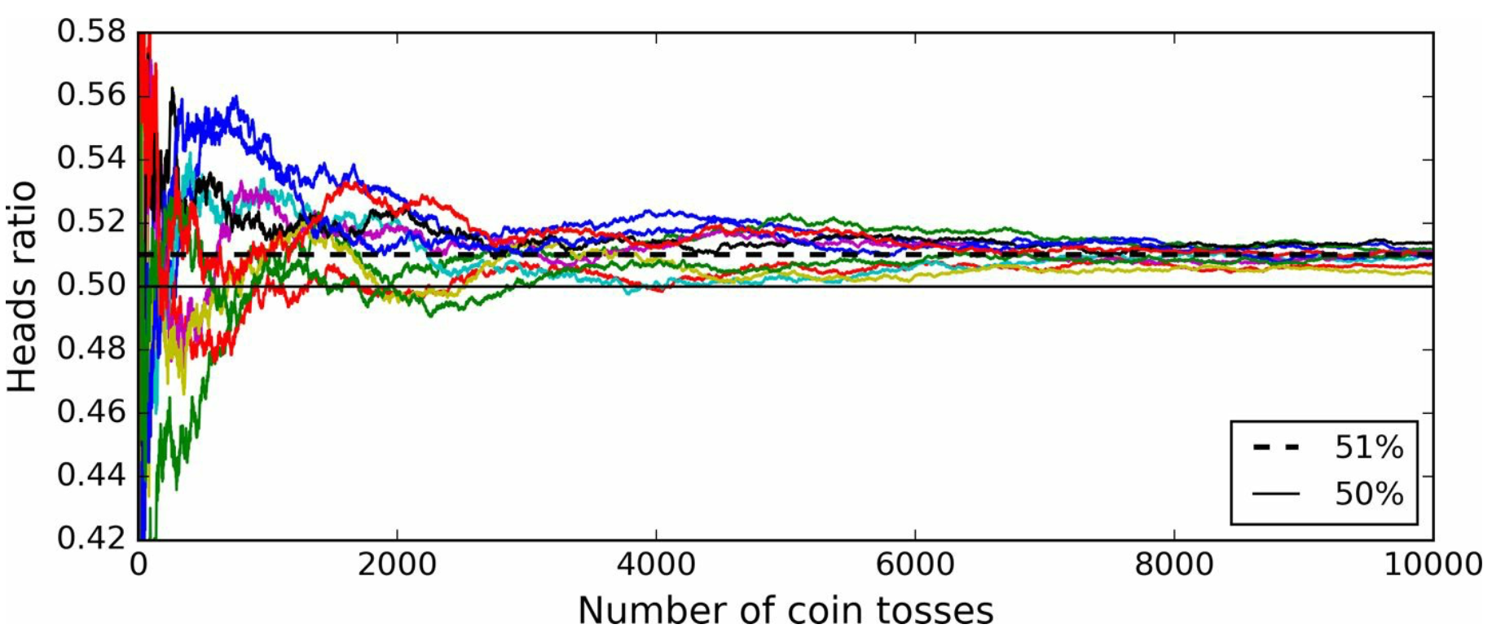
Ensemble Models – Law of Large Numbers
Notes:
This plot shows the ratio of heads obtained with increasing number of coin tosses for 10 different trials. You can see that, while it’s quite chaotic at a low number of tosses (our coin is only very slightly biased after all), after a few thousand tosses, all the trials converge and end up being so close to 51% that they are all above 50%.

Slide 23
Ensemble Models – Law of Large Numbers
Ensemble classifier of 1000 weak predictors (accuracy of 0.51) can result in ~75% accuracy!
Only if
All classifiers completely independent
All errors made by each classifier completely uncorrelated
More of a “theoretical maximum”
Notes:
Similarly, if we build an ensemble containing 1000 classifiers that are individually correct only 51% of the time (i.e. about as weak a classifier as you can get for balanced classes) and predicted using a hard voting classifier that just reported the majority voted class, thanks to the law of large numbers, you could hope for an accuracy of 75%! Technically, that 75% would only be achievable if every classifier was perfectly independent and made uncorrelated errors. Since we’re training on data from the same source, each classifier is likely to make the same types of errors, reducing the ensemble’s accuracy.

Slide 24
Ensemble Models – 6 Ways to Improve Accuracy
Notes:
There are a few tricks we can pull though to increase the accuracy of the ensemble.
I’m going to show you 6 ways that we can improve an ensemble’s performance.

Slide 25
Ensemble Models – 6 Ways to Improve Accuracy
Use varied algorithms
Notes:
Firstly, in order to restrict the correlation of errors in the prediction, we could ensure that the ensemble is constructed from predictors that use different algorithms. Different algorithms are more likely to make different types of errors, reducing the correlation between the predictors and improving the ensemble accuracy.

Slide 26
Ensemble Models – 6 Ways to Improve Accuracy
Use varied algorithms
Use better aggregation functions
Notes:
Secondly, we have already discussed how moving from a “Hard Voting” classifier to a “Soft Voting” one can provide a boost to predictive accuracy of the ensemble as a whole. We can also improve the functions that we are using to aggregate our predictions. For instance, in a regression problem, where we are not necessarily trying to identify a class for an instance, it makes little sense to take the mode of the predictions. Unless we are truncating our predictor’s precision to a small number of decimal places it is very unlikely that multiple predictors will predict exactly the same value for a given instance. In this regard, using the geometric mean of all predictions is much more likely to provide better results.

Slide 27
Ensemble Models – 6 Ways to Improve Accuracy
Use varied algorithms
Use better aggregation functions
Split training data across predictors
Notes:
Thirdly, we could train each predictor in the ensemble on different random subsets of the training set. Since our data still comes from the same source this isn’t a sure-fire way to improve accuracy, but it can help account for outliers and auxiliary patterns within the data by splitting it up. Let’s look at this in a bit more detail.

Slide 28
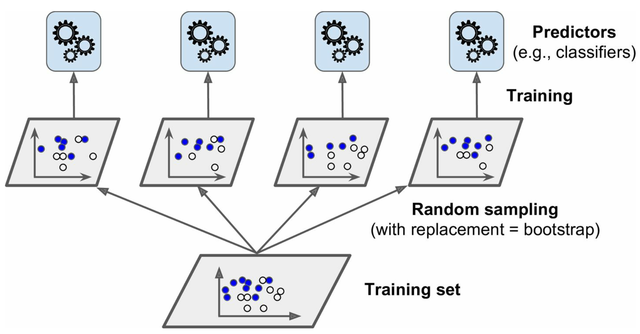
Ensemble Models – Bagging and Pasting
(with replacement = bagging)
(without replacement = pasting)
Notes:
Two common methods of modifying the input data are “bagging” and “pasting”. Data is pulled from the entire training set and randomly assigned into samples. When the samples are assigned WITH replacement (i.e. we take a random datum from the training data and then randomly assign it to predictors 2 and 3, but then put it back into our training set for the next iteration), the process is called “bagging”. If the assignment is performed without replacement, it is called “pasting”.
Both bagging and pasting allow training instances to be sampled several times across multiple predictors (in the previous example, the datum appears in the training data for both predictors 2 and 3). However, only bagging allows training instances to be sampled several times in the same predictor.

Slide 29
Ensemble Models – Bagging and Pasting
Bagging generally most powerful
Good with small data
Good cross-validation results
“Out of bag” instances
Notes:
This makes Bagging especially powerful when operating on small data sets, but as a general rule, bagging ends up outperforming pasting in most cases, especially when cross-validating.
One other thing to consider with bagging is that, while some instances can be sampled multiple times in the same predictor, other instances may not be randomly selected at all and will not appear in the sample. These are called “out of bag” instances, and are never seen by the classifier so can be used for validation.

Slide 30
Ensemble Models – Bagging and Pasting
Bagging generally most powerful
Good with small data
Good cross-validation results
“Out of bag” instances
Pasting less commonly used but
Good when computing power limited
Good when multiple samples of same instance is unphysical
Notes:
Since bagging is so powerful, Pasting is much more rarely used, but can be useful for large datasets where computing power is limited or where there is the specific data limitation that two occurrences of the same unique data point do not make physical sense.
What questions do we have about bagging and pasting?

Slide 31
Ensemble Models – 6 Ways to Improve Accuracy
Use varied algorithms
Use better aggregation functions
Split training data across predictors
Split features across predictors
Notes:
A fourth way we can improve accuracy is by using a similar idea to bagging, but sampling the input features instead. By assigning each predictor a subset of the features, we can trade a bit more bias for lower variance for each predictor. Sampling both the training data and the features is called the “Random Patches” method, whereas keeping all training data for all predictors and only sampling the features is called the “Random Subspaces” method.

Slide 32
Ensemble Models – 6 Ways to Improve Accuracy
Use varied algorithms
Use better aggregation functions
Split training data across predictors
Split features across predictors
Sequentially train predictors
Notes:
For number 5, we can use “boosting”, which sequentially trains the weak predictors in the ensemble, with each subsequent predictor trying to correct the errors of its predecessor.

Slide 33
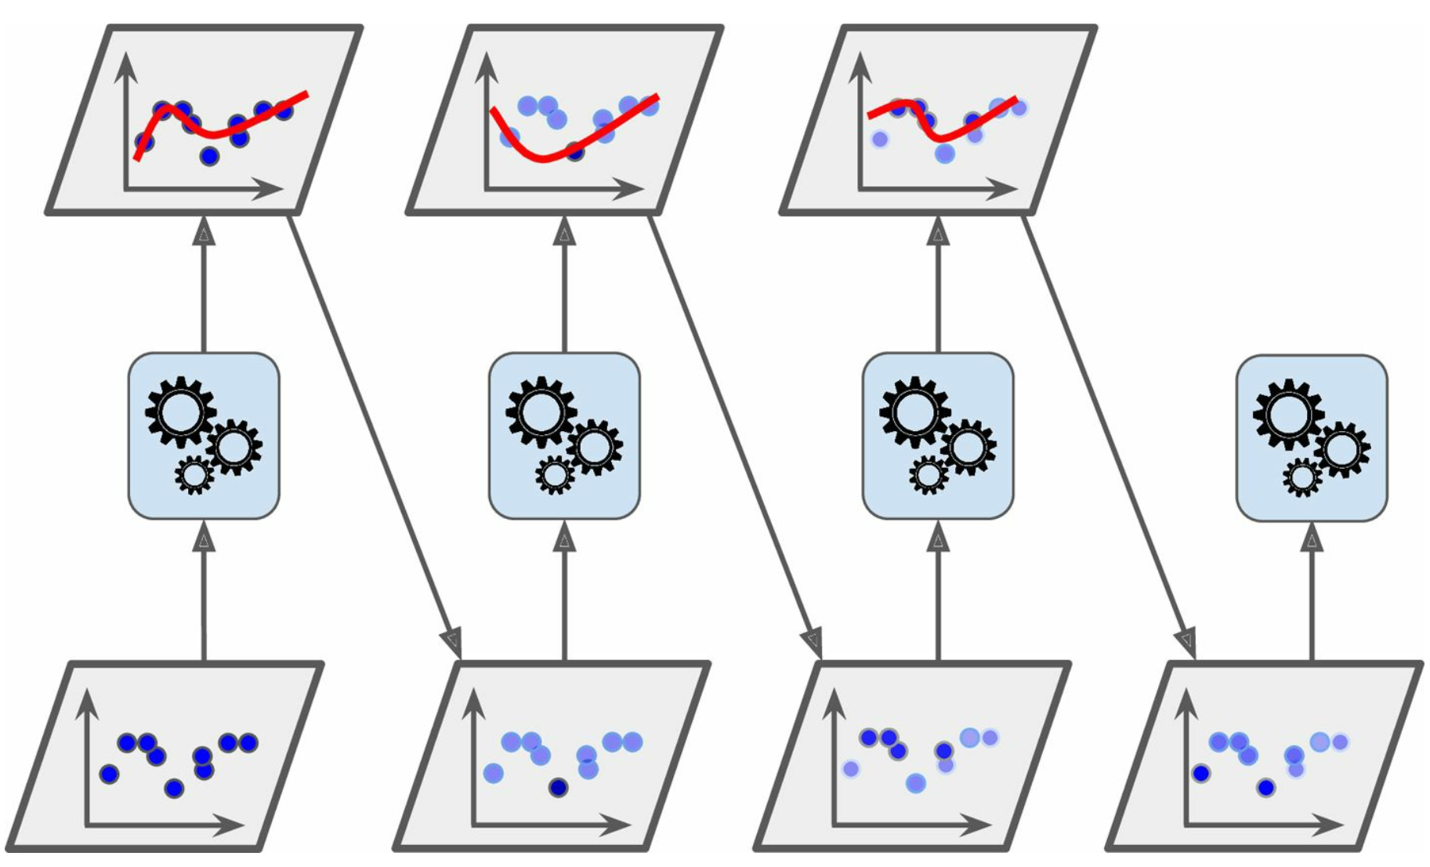
Ensemble Models – Boosting
Notes:
For instance, in this case, the first classifier gets many instances wrong and so the weights of those instances get boosted. The second classifier therefore does a better job at predicting those underfitted instances, but misses some others as a result. The third therefore tries to account for the errors of the second and so on.
Once all the predictors are trained, the ensemble makes predictions as normal, except now the predictors themselves have different weights depending on their overall accuracy on the weighted training set.
One key disadvantage here is that this process cannot be parallelised, as each subsequent predictor requires the predictions of its predecessor.

Slide 34
Ensemble Models – Boosting – AdaBoost Process
Notes:
One of the most powerful and commonly used boosting process is the Adaptive Boosting or AdaBoost methodology. The process of AdaBoosting looks something like this:

Slide 35
Ensemble Models – Boosting – AdaBoost Process
For each predictor $j$, the instance weight $w^{(i)}$ is initially set to $\frac{1}{m}$.
Notes:
Firstly each instance is given an initial of 1/m, where m is the total number of instances in the dataset.

Slide 36
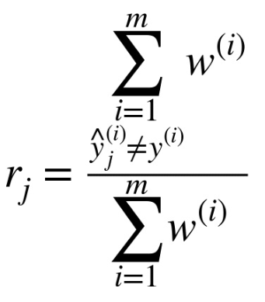
Ensemble Models – Boosting – AdaBoost Process
For each predictor $j$, the instance weight $w^{(i)}$ is initially set to $\frac{1}{m}$.
The first predictor is trained and the error rate $r_{1}$ calculated.
$r_{j}$ -- Weighted error rate of predictor $j$
$w^{(i)}$ -- Weight of instance $i$
${\hat{y}}_{j}^{(i)}$ -- Prediction from predictor $j$ for instance $i$
$y^{(i)}$ -- Actual value of instance $i$
$m$ -- Total number of instances
Notes:
The first predictor is trained, and we can calculate an error rate for that predictor. This is the sum of the weights on each instance for all cases where the predictor misclassified the instance, divided by the sum of all instance weights (which is initially 1)

Slide 37
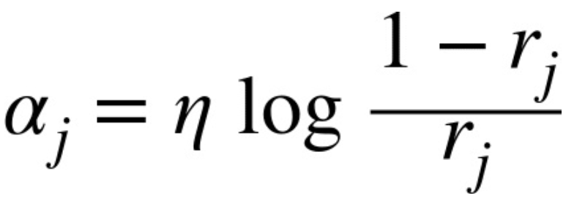
Ensemble Models – Boosting – AdaBoost Process
For each predictor $j$, the instance weight $w^{(i)}$ is initially set to $\frac{1}{m}$.
The first predictor is trained and the error rate $r_{1}$ calculated.
The predictor’s weight $α_{j}$ is then calculated.
$α_{j}$ -- Weight of predictor $j$
$η$ -- Learning rate
$r_{j}$ -- Weighted error rate of predictor $j$
Notes:
The predictor’s error rate can be used to calculate its weight for the ensemble aggregation, alpha. Predictors that have a larger error rate (rj) are weighted less strongly than those that have a lower error rate. An important AdaBoost hyperparameter here is eta, which is defined as the “learning rate” for the process. This prefactor controls how much the weight of each misclassified instance is boosted by. Halving the learning rate means that the instance weight for the next iteration is boosted by half as much, leading to smaller corrections on the next iteration. Usual machine learning caveats apply – stronger learning rates lead to better predictions but could cause overfitting that restricts generalization ability for the ensemble.

Slide 38
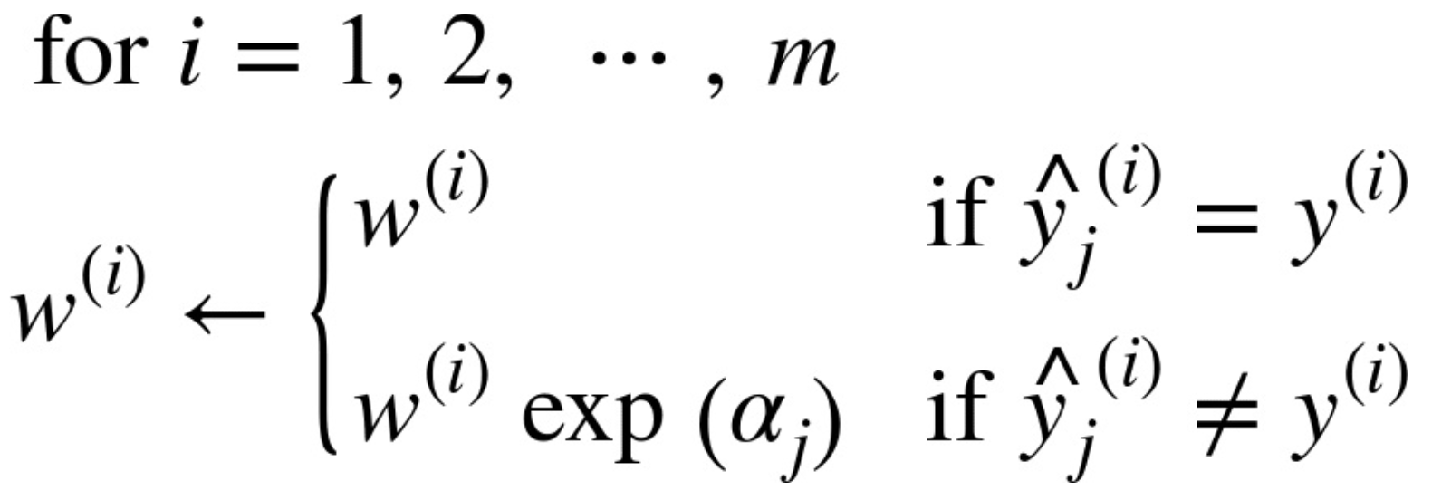
Ensemble Models – Boosting – AdaBoost Process
For each predictor $j$, the instance weight $w^{(i)}$ is initially set to $\frac{1}{m}$.
The first predictor is trained and the error rate $r_{1}$ calculated.
The predictor’s weight $α_{j}$ is then calculated.
The instance weights are updated.
$m$ -- Total number of instances
$w^{(i)}$ -- Weight of instance $i$
${\hat{y}}_{j}^{(i)}$ -- Prediction from predictor $j$ for instance $i$
$y^{(i)}$ -- Actual value of instance $i$
$α_{j}$ -- Weight of predictor $j$
Notes:
Based on the previous predictor’s weight alpha_j, the instance weights are updated for the next predictor. No change is made if the instance was predicted correctly, whereas the weight on instances that were predicted incorrectly are updated to include this exponential prefactor.

Slide 39
Ensemble Models – Boosting – AdaBoost Process
For each predictor $j$, the instance weight $w^{(i)}$ is initially set to $\frac{1}{m}$.
The first predictor is trained and the error rate $r_{1}$ calculated.
The predictor’s weight $α_{j}$ is then calculated.
The instance weights are updated.
These instance weights are normalized by $\sum_{i=1}^{m}{w^{(i)}}$.
Notes:
After the update, the instance weights are renormalized to ensure that they add up to 1. The next predictor is then trained with the new instance weights (the process returns to step 2 and repeats)

Slide 40
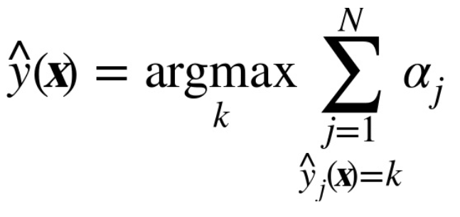
Ensemble Models – Boosting – AdaBoost Process
For each predictor $j$, the instance weight $w^{(i)}$ is initially set to $\frac{1}{m}$.
The first predictor is trained and the error rate $r_{1}$ calculated.
The predictor’s weight $α_{j}$ is then calculated.
The instance weights are updated.
These instance weights are normalized by $\sum_{i=1}^{m}{w^{(i)}}$.
The final AdaBoost prediction is the class that received the majority of the weighted votes:
$\hat{y}\left(x\right)$-- Prediction from aggregator
${\hat{y}}_{j}^{(i)}$ -- Prediction from predictor $j$ for instance $i$
$α_{j}$ -- Weight of predictor $j$
$N$ – Number of predictors
Notes:
After all predictors are trained, the final aggregated prediction for each instance is calculated as the class that was predicted by the majority of weighted votes.
Questions?

Slide 41
Ensemble Models – 6 Ways to Improve Accuracy
Use varied algorithms
Use better aggregation functions
Split training data across predictors
Split features across predictors
Sequentially train predictors
Train model for aggregation
Notes:
Finally, there is “stacking”. This tries to improve the aggregation phase of the ensemble model by training ANOTHER model, called a blender, to perform the aggregation rather than using a simple function (like the mean or mode etc.).

Slide 42
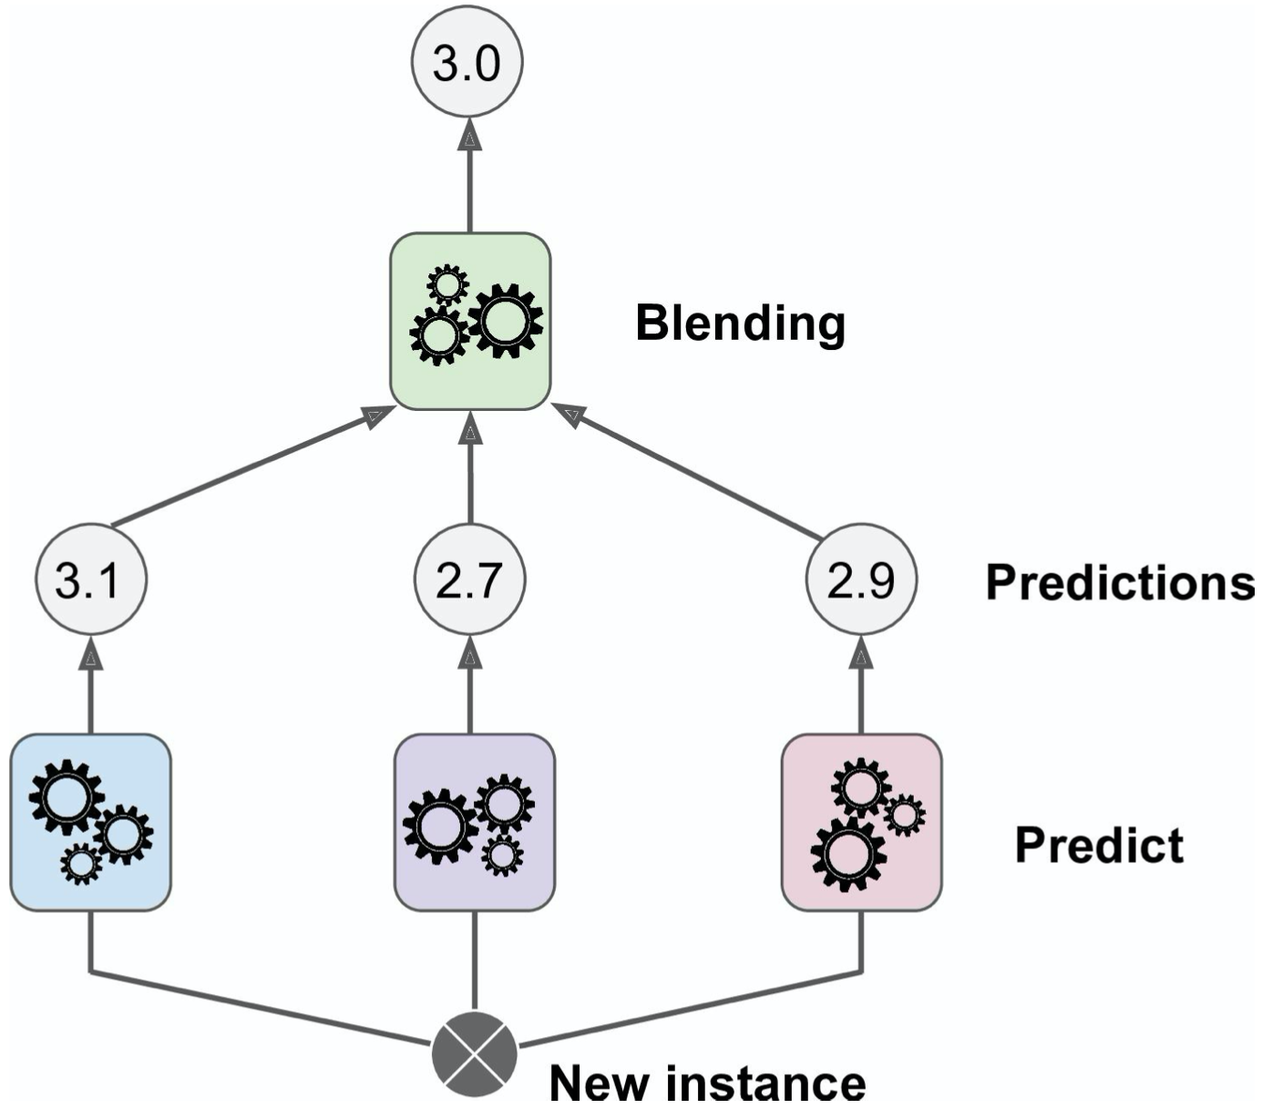
Ensemble Models – Stacking
Notes:
Here’s a schematic of what that looks like. It’s similar to what we’ve already been looking at (this is a regression problem rather than a classification problem), but we have a second layer of machine learning that find the optimal way to combine the predictors in the blending phase.

Slide 43
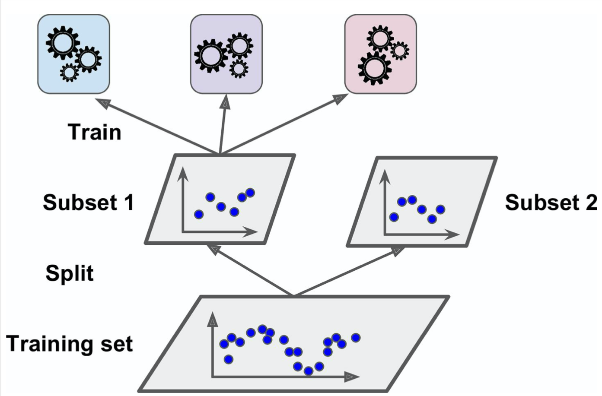
Ensemble Models – Stacking
Notes:
This generally works by splitting the training set into two. The first subset is used to train the predictors in that initial ML layer, whereas the second subset is set off to the side (kind of like you would do with splitting a dataset into the training and test datasets for a conventional ML problem).

Slide 44
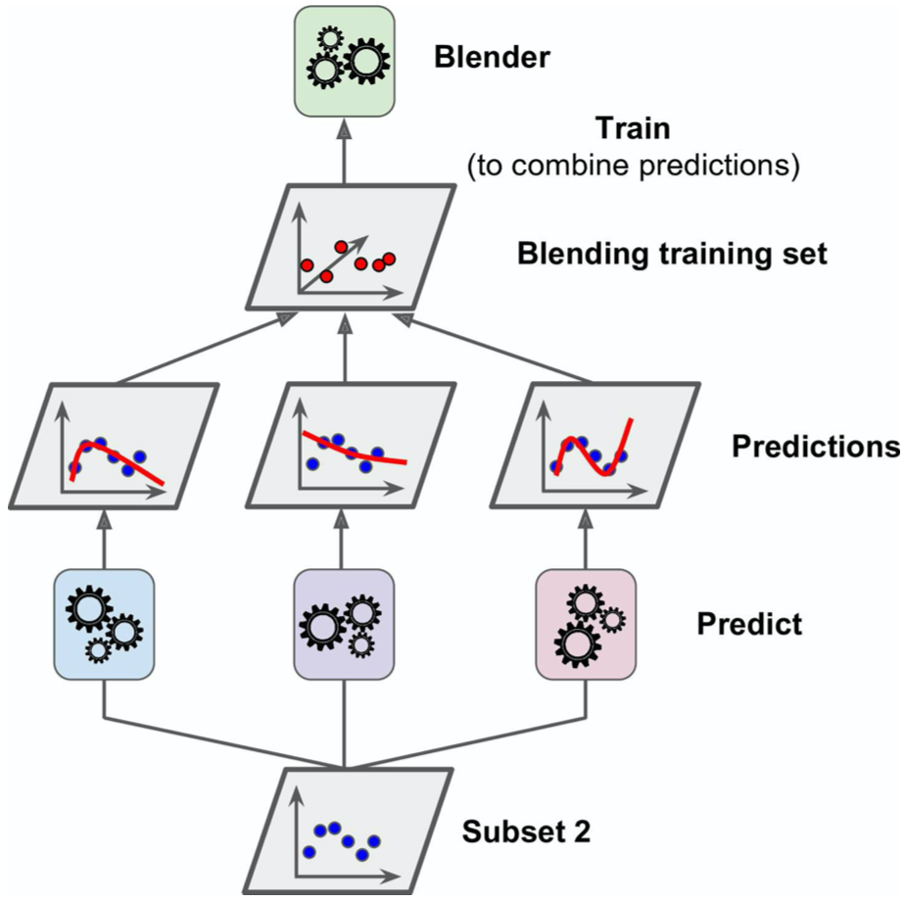
Ensemble Models – Stacking
Notes:
The second subset is then pumped through the trained predictors in order to obtain the predictions from the first layer.
These predictions then form the data inputs to the Blender, which is trained on those predictions to work out how best to combine them.

Slide 45
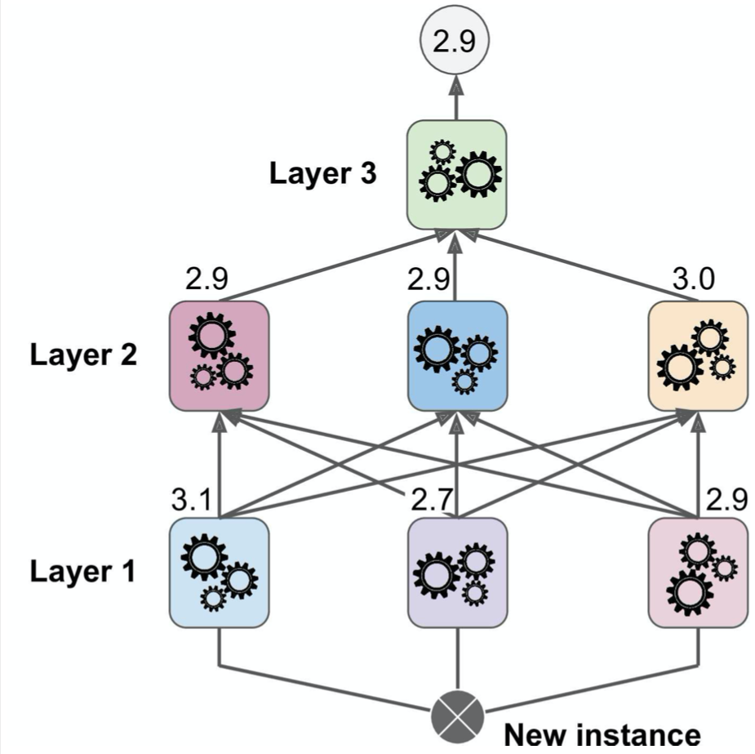
Ensemble Models – Stacking
Notes:
You may be able to see how could expand this to train more and more layers and in fact you can build something that looks a lot like a feedforward artificial neural network. This time, however, instead of being opaque matrix multiplications that transform the data without providing much insight into the physical relevance of what’s going on under the hood, we can build the network from more transparent machine learning algorithms like decision trees or Logistic Regression and obtain feature importances at each stage. Wild!

Slide 46
Ensemble Models – 6 Ways to Improve Accuracy
Use varied algorithms
Use better aggregation functions
Split training data across predictors
Split features across predictors
Sequentially train predictors
Train model for aggregation
Notes:
Hopefully this has given you some useful things to think about when considering building your own ensemble models. I’m going to head over to a Jupyter Notebook to show you how you can implement some of these processes in scikit learn at the end of the presentation, but in the meantime, what questions do we have on what we’ve covered so far?

Slide 47
Random Forests
Notes:
In that case, let’s talk a little bit more about Random Forests specifically – an ensemble model where the predictors are decision trees.

Slide 48
Random Forests – Overview
An ensemble of Decision Tree models
Generally trained via bagging
Introduces extra randomness when growing trees
Generally same hyperparameters as Decision Trees:
Notes:
Generally, these models are trained using the Random Patches method, where bagging is used to split up training data for each tree, and feature lists are also split so that each tree can only make decisions on a subset of the main feature set.
This adds additional randomness to the growing of the trees, increasing the bias for each individual predictor with the aim of reducing overall bias and variance at the aggregation step.
The training of the random forest is mostly dependent on the way that the trees are grown, so you’ll generally find that the hyperparameters between trees and forests are pretty much the same:

Slide 49
Random Forests – Hyperparameters
max_depth
Number of layers of splits in each tree
min_samples_split
Minimum number of samples required to split a node
min_samples_leaf
Minimum number of samples required to be a leaf node
max_leaf_nodes
Stop growing trees when this many leaves are made
min_impurity_decrease
Split nodes when the impurity decreases by this value or more
max_features (when using RandomForestClassifier)
The maximum number of features to consider when looking for the best split
n_estimators
Total number of trees in the forest
bootstrap
Whether to use bagging or not
max_samples
The number/proportion of samples to draw from the training set to train each estimator
max_features (when using BaggingClassifier)
The number of features to draw from the training set to train each estimator
Notes:
On the left here you’ll see all the hyperparameters available in scikit learn that control the way each tree is being grown. These are the same in the DecisionTreeClassifier class as well as the RandomForestClassifier class. I think these ones should be familiar to you guys?
The hyperparameters on the right are specific to the RF class and control how big the forest is, or how the Random Patches methodology works.

Slide 50
Random Forests – Feature Importance
As with a Decision Tree, the important features are split on first
Can estimate a feature’s importance by calculating the average depth that is appears across all trees
Notes:
Since decision trees are the constituent parts of a random forest, we get all the advantages we get with decision trees too, such as the fact that, during training, the splits that are performed first in each forest are the ones that provide the largest information gain through impurity calculations. By determining the average depth of a particular feature across all the trees, we can estimate the overall importance of the feature in the forest.
This makes restricting the number of features that each tree has access to very powerful. A high variance in the depth at which a particular feature appears across all trees is indicative of a feature that is only important under certain circumstances, or has a complex dependence relationship with one or more other features, again providing more information about the system that can be useful in learning more about the input data.

Slide 51
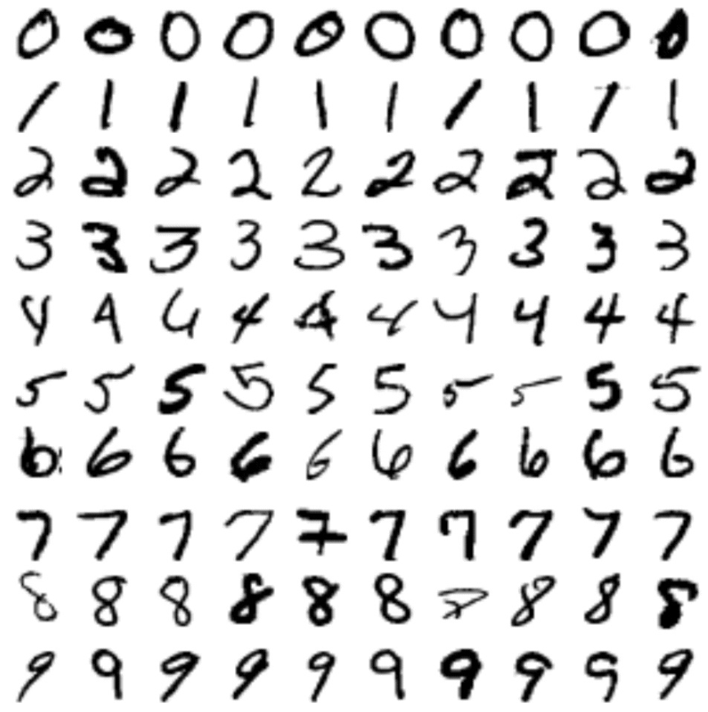
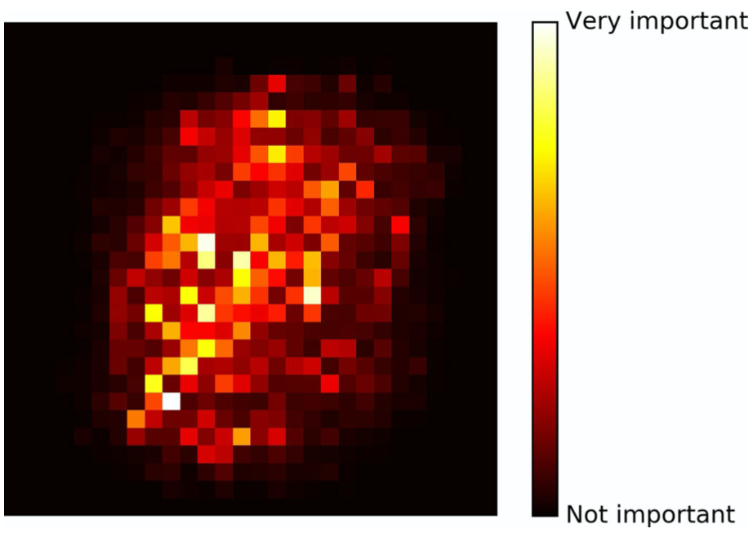
Random Forests – Feature Importance
As with a Decision Tree, the important features are split on first
Can estimate a feature’s importance by calculating the average depth that is appears across all trees
Notes:
I’ve provided an example here from the MNIST dataset, which your fruitfly classification tutorial. The dataset includes a ton of handwritten digits, and the random forest’s job is to classify what each digit is. The heatmap on the right highlights the pixel locations that are most important for distinguishing what the digit is.
I am a big advocate for these kinds of studies. While feature importance is only an approximation, it can frequently provide very useful insights into our data, which help us learn much more about our data and processes than if we just get the answer out along with an accuracy metric. I’m looking at you, Neural Networks.

Slide 52
Random Forests – Ömñï£ðrê§†
Notes:
Over at Kount, one of our best-performing models that we provide to our customers is a Random Forest called Omniforest. This is a real-world, real-life model that businesses pay lots of money to access and catches and prevents many hundreds of millions of dollars of fraud every year.

Slide 53
Random Forests – Ömñï£ðrê§†
40 decision trees
Depth of 30
2³⁰ = 1B leaf nodes
105 features total
Random Subspaces: 30 features per tree
No Bagging/Pasting
Notes:
The model consists of 40 decision trees, each with a maximum of 30 layers of decision points. This means each tree has up to 1B leaf nodes each.
Every couple of months we pull down 100M of Kount’s most recent transactions and train the forest. Firstly, we generate 105 features for each transaction, resulting in a total sample space of about 10B elements. We then split out 70% of our training data to train the forest on, with the remaining 30% comprising the validation set. Each tree gets to see 30 features selected at random using the Random Subspaces method. We don’t use Random Patching here because bagging and pasting were found to not improve our model accuracy very much – likely because of how large our dataset is.

Slide 54
Random Forests – Ömñï£ðrê§†
40 decision trees
Depth of 30
2³⁰ = 1B leaf nodes
105 features total
Random Subspaces: 30 features per tree
No Bagging/Pasting
Significantly more accurate than non-ensemble methods
Can learn multiple fraud patterns simultaneously (trees/forest regions)
Can better navigate complex feature dependencies
Each tree highly tuned
Overfitting closely monitored to optimise predictive capability
Notes:
You’ll notice that with potentially 30 layers and 1B leaf nodes in each tree, this is an extremely complex model. This is important because of the huge variation in transaction types that we see at Kount. For instance – we need to be just as good at predicting fraud when someone buys a donut from Dunkin’ as we are when someone is buying 1,000 laptops from Staples, or registering the paychecks for 100 employees through Intuit Quickbooks. Having very complex trees allows incoming transactions to trickle through the forest to specific regions of the trees that are particularly good at identifying the relevant, specific fraud signal. However, this massive complexity can quickly lead to overfitting, which is why we leverage Random Subspaces. The per-tree hyperparameters are also highly tuned to optimise the predictive capability and generalisation to new transactions.
What questions do we have about Omniforest or random forests in general before we move on to some examples of ensemble models?

Slide 55
Notebook Examples…

